Slide 1
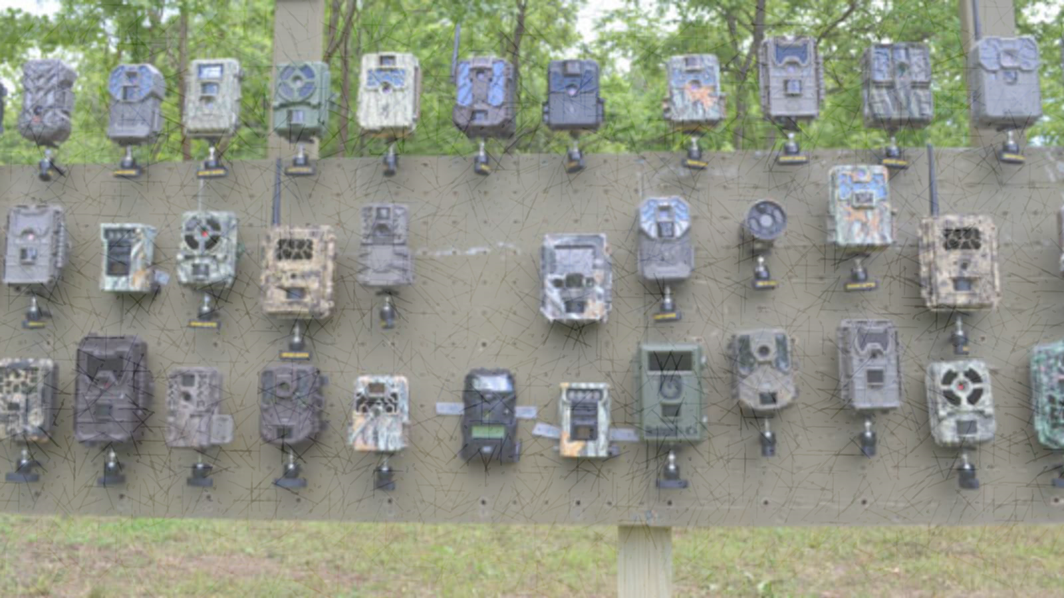

Finding the sweet spot in camera trapping: a global synthesis and meta-analysis of net abundance and richness detection rates as an index of sampling effort.
Nargol Ghazian and Christopher J. Lortie

Slide 2
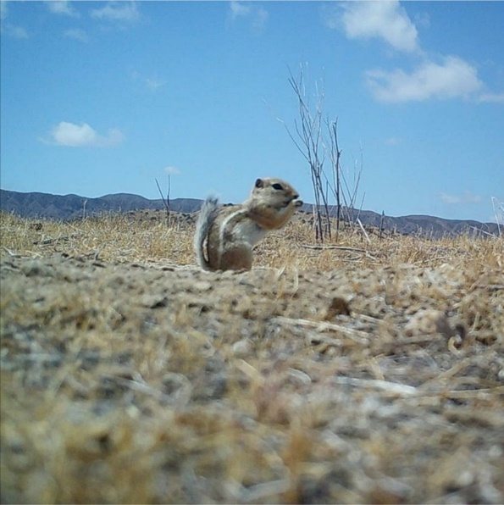
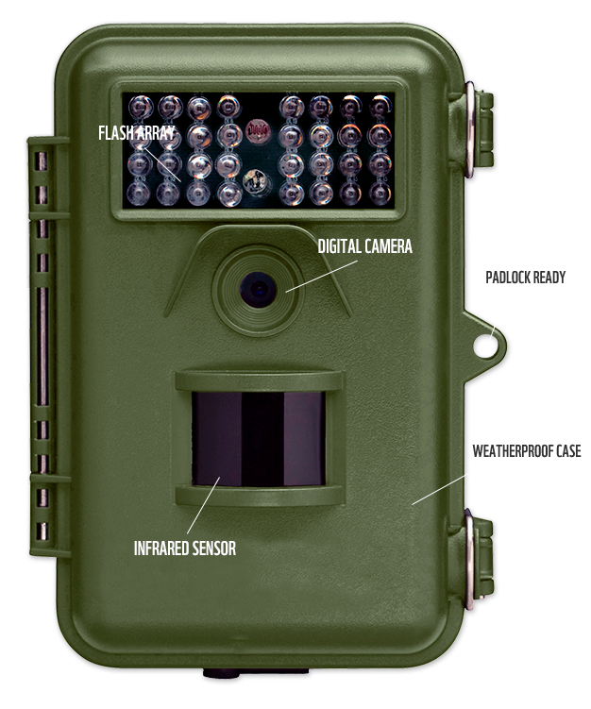
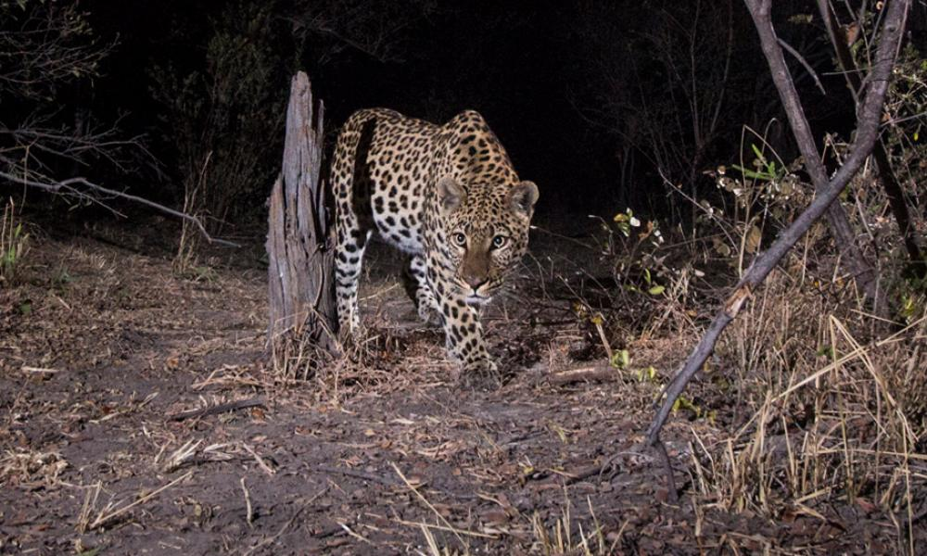
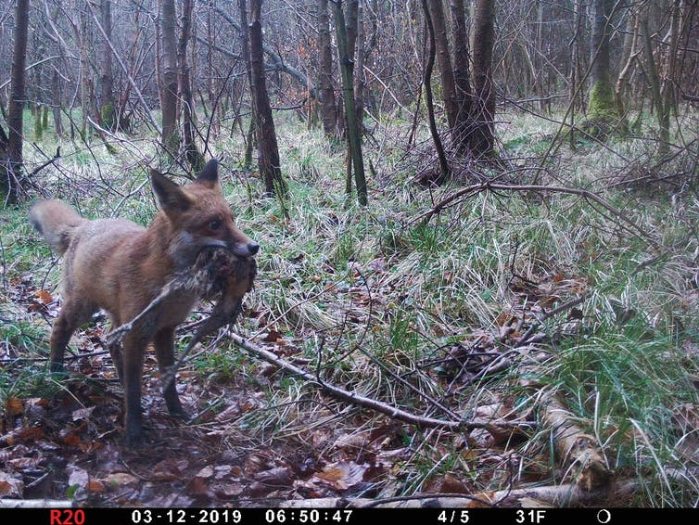
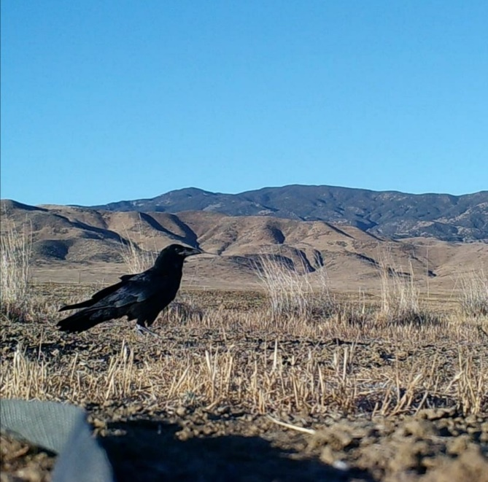
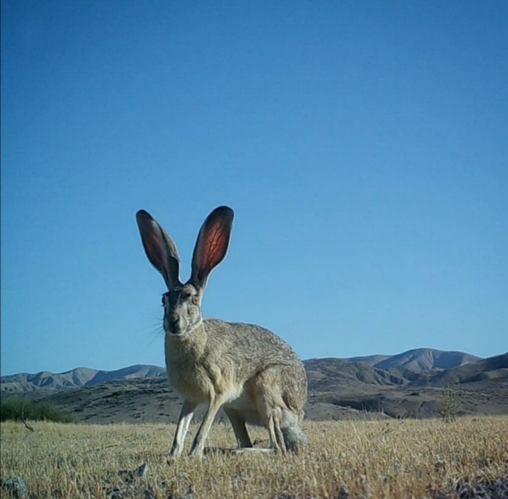
Some photos are courtesy of Google Images
Notes:
Some photos are courtesy of Google Images

Slide 3
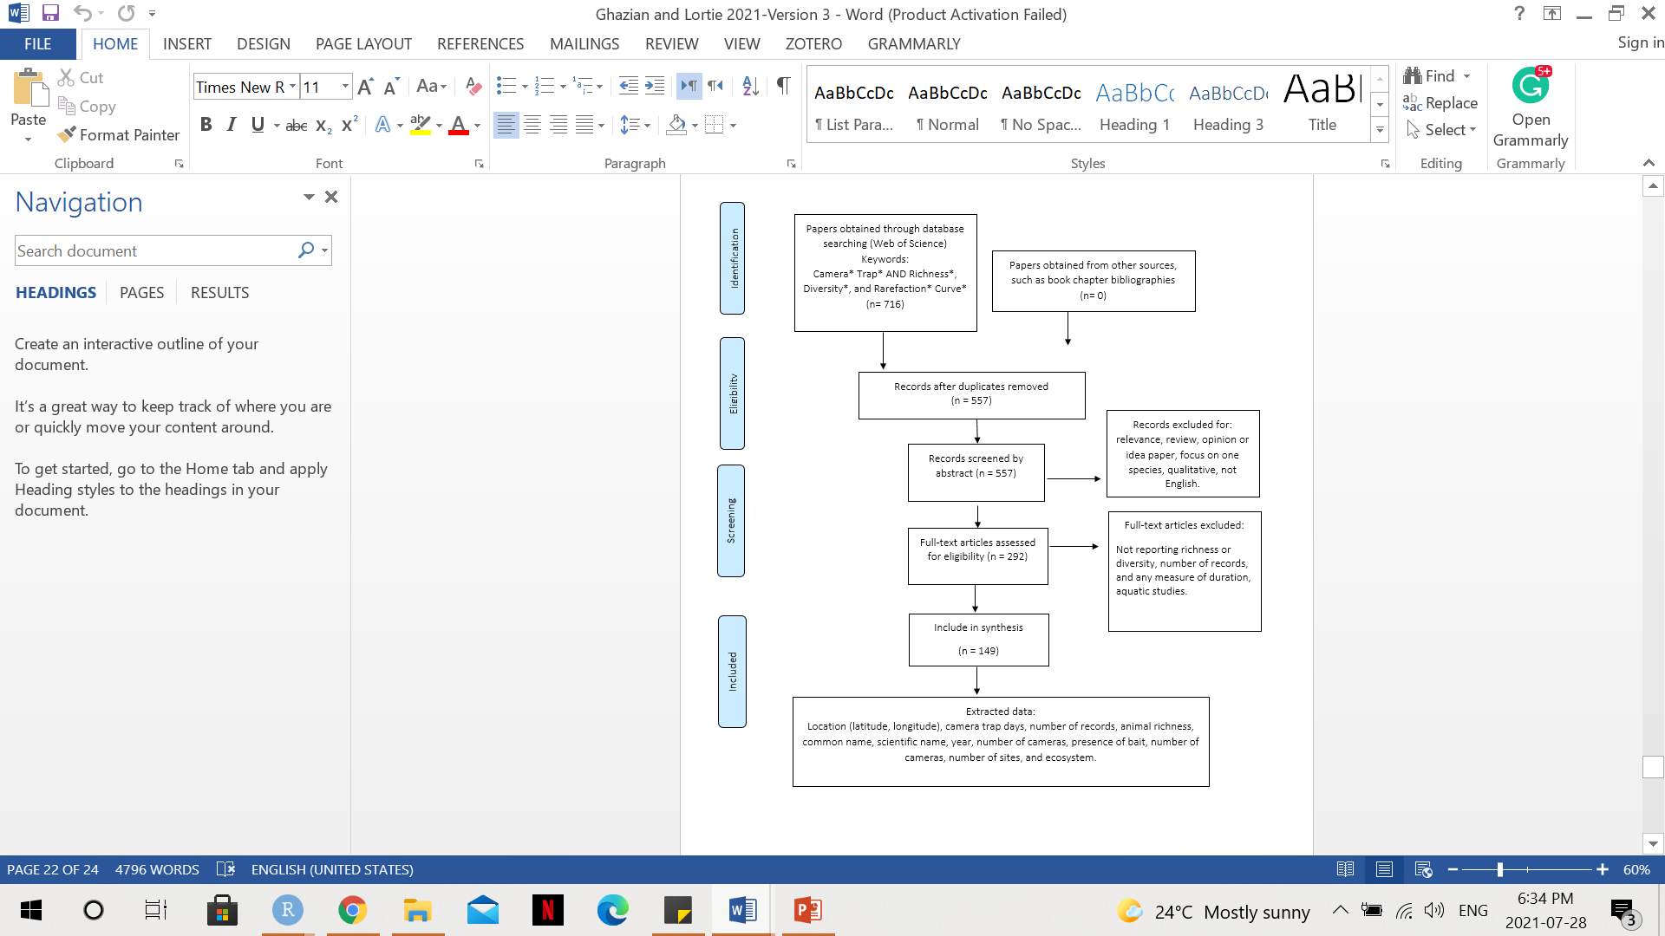
PRISMA diagram adapted from Moher et al. (2009)

Slide 4
Two Effect Size Indices
Net Abundance Detection Rate = Number of Animals/Number of cameras/Number of Days
Net Richness Detection Rate = Number of Species/Number of Cameras/Number of Days

Slide 5
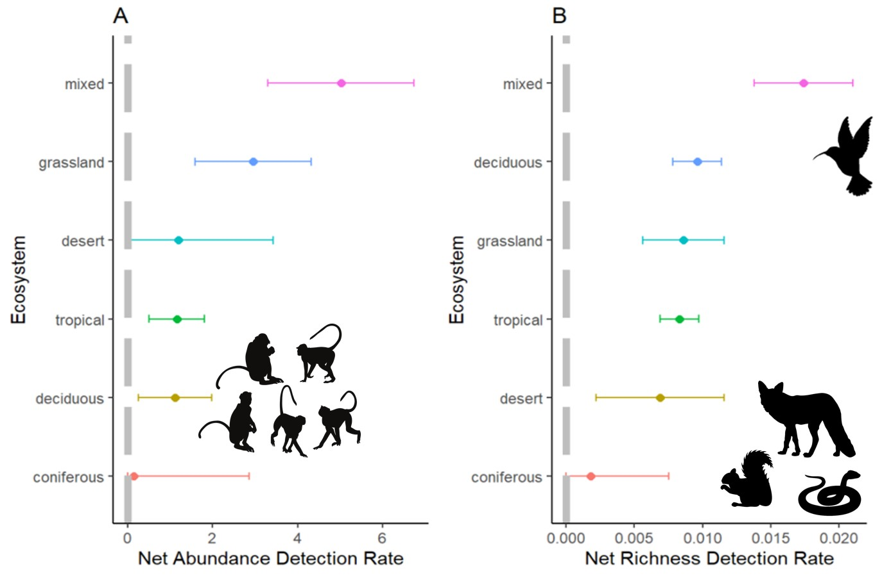
Figure 1. Forest plots showing estimate effect sizes from random-mixed model output for net abundance detection rate (A, number of animals/number of cameras/number of days) and net richness detection rate (B, number of species/number of cameras/number of days) in 6 different ecosystems of study. Dots represent the meta-analytic mean and dashed lines represent the 95% confidence intervals.

Slide 6
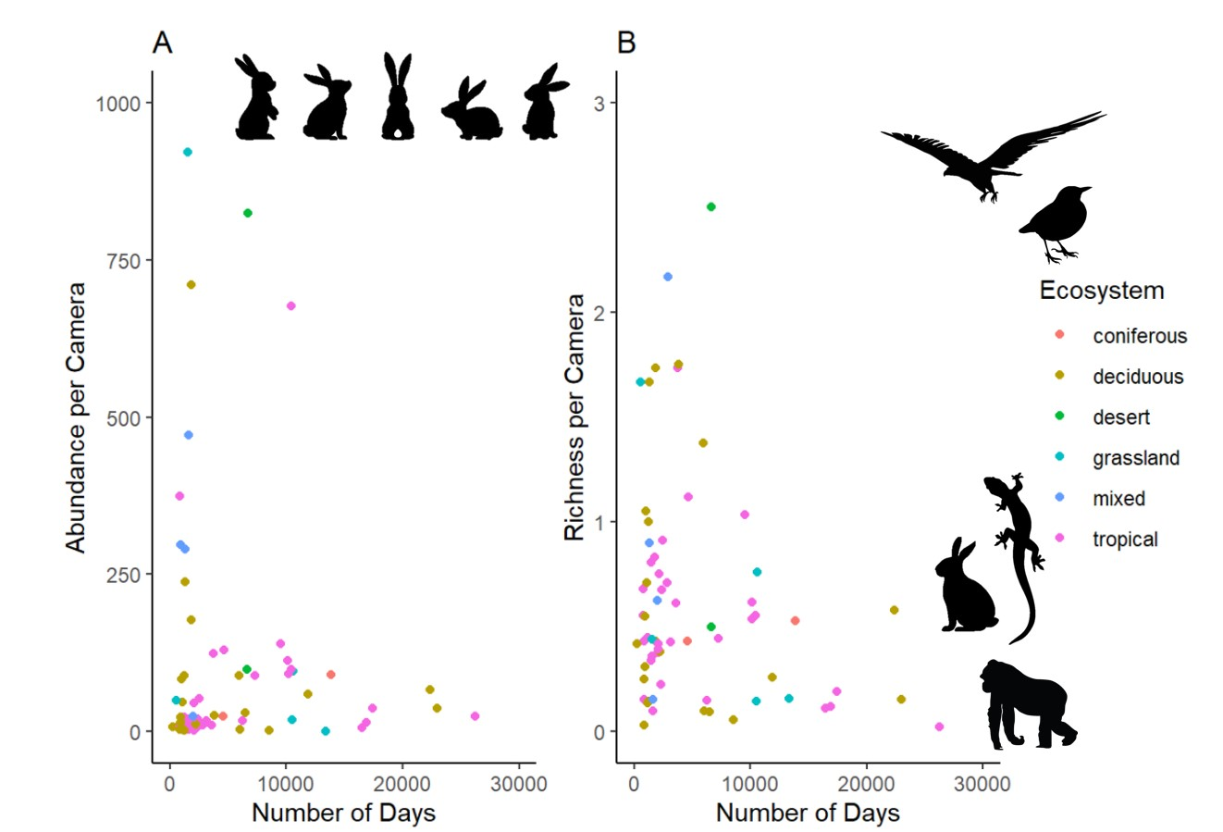
Figure 2. Weighted regression plot showing the relationship between the number of animals per camera (A) and the number of species per camera (B) throughout the duration of the study (days), weighted by the variation in abundance or richness. Coloured dots represent the ecosystem of study.

Slide 7
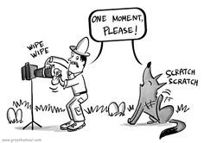
Takeaways
Camera traps work effectively to estimate richness in almost all ecosystems and abundance in grassland and mixed systems
Understanding how landscape-level differences influence animal assemblage in different ecosystems offers us valuable insight into the utility of camera traps in different regions
Deploying a greater number of cameras for a shorter duration rather a few for longer is a more effective sampling method
Camera traps will continue to rise in popularity, specially given their cross-implementation with AI studies
Well-planed experimental designs are key to maximizing the extent of surveys

Slide 8


Thank You!
Dr. Suzanne MacDonald
Dr. Laura McKinnon
York University Faculty of Graduate Studies
NSERC

